Slide 1

Film Production Analysis

Slide 2
Project Overview
This project aims to identify successful film trends in the current box office landscape to guide the strategic direction of our company's newly established movie studio.

Slide 3
Business Understanding
The movie industry has undergone significant changes over the years, evolving considerably over time. This highlights the importance of identifying the types of films that resonate most with audiences around the world today.
Key Business Questions
What are the best-performing Genres in the Movie Industry?
How does Production Budget cost affect the success or performance of the movies?
Which director dominates the movie industry?

Slide 4
Data Understanding
The data we used for analysis are from:
Box Office Mojo: It is used to track box office revenue and performance of movie.
IMDB: It serves as a comprehensive database for movie, TV, and celebrity information.
Rotten Tomatoes: It is a website used for movie reviews and rating.
TheMovieDB: This is a community built movie and TV database..
The Numbers: It offers data and analysis on movie box office earnings, production budgets, and related financial aspects.

Slide 5
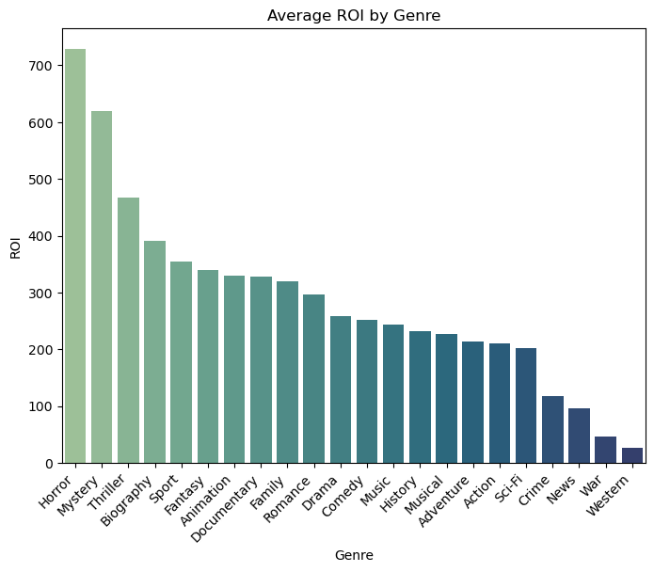
The graph shows that Horror movies have the highest average Return On Investment (ROI), while Western movies have the lowest average Return On Investment.

Slide 6
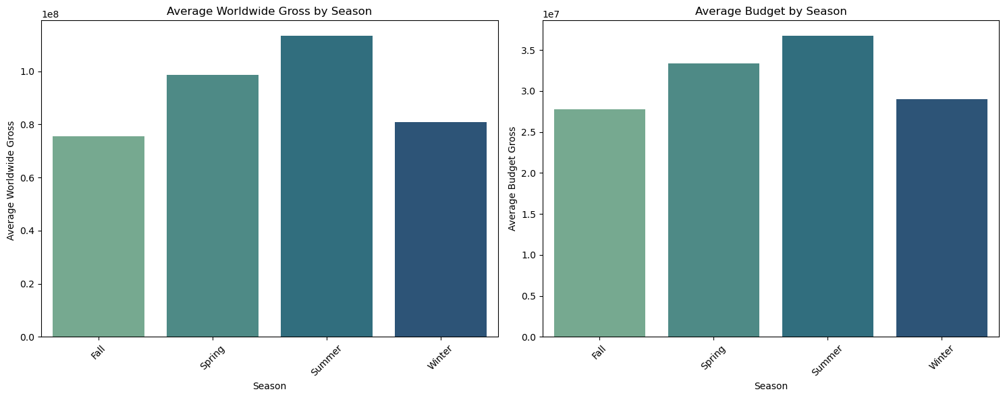

Slide 7
Findings
It is apparent that movies released in the summer are of have the highest budget allocations, as well as the highest worldwide gross.
This can be attributed to the fact that summer coincides with school holidays and family vacations in many parts of the world, making it excellent for primetime viewership.
This translates to studios allocating higher budgets to attract large audiences, ensuring a better return on investment.

Slide 8
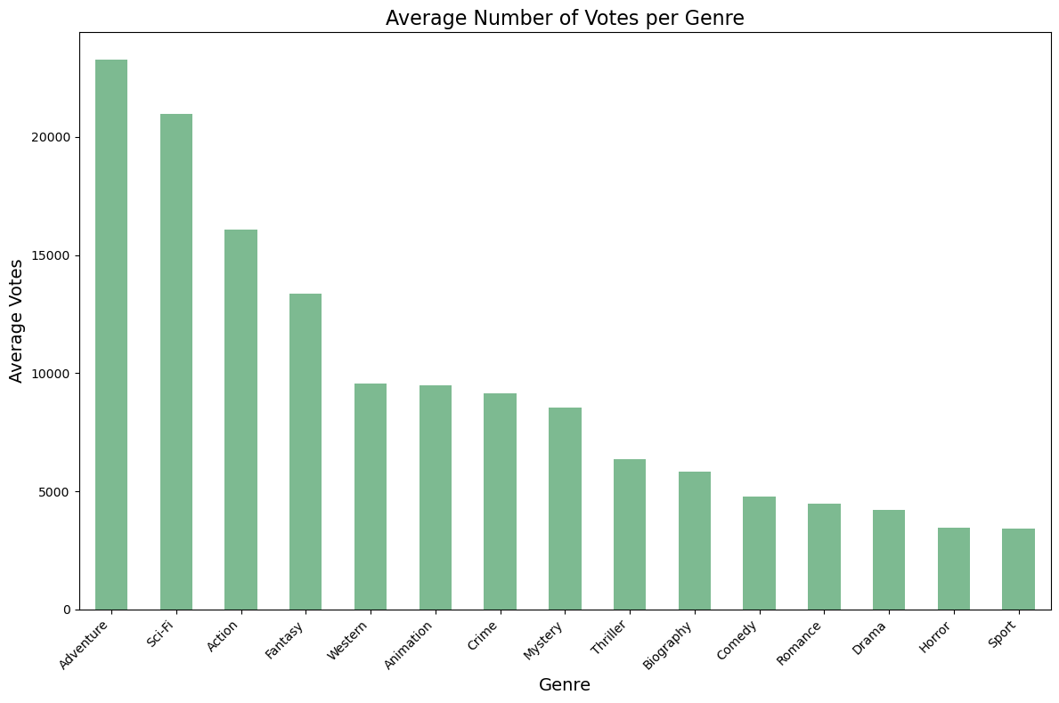
Adventure tops the list in votes per genre, portraying their popularity amongst audiences worldwide.

Slide 9
Recommendations
Recommendations to capitalize on the never ending popularity of Adventure, Sci-Fi, Action, Fantasy etc:
Developing original stories and adaptations of successful novels, comics, or games in these genres.
Ensuring visually appealing designs and groundbreaking special effects to elevate audience experiences.
Allocating significant budgets to ensure production quality, especially in Sci-Fi and Fantasy themes.
Audiences are often drawn to unique, immersive worlds and innovative storytelling

Slide 10
Cont…
Recommendations to capitalize on the high ROI of horror movies and other similar genres:
Focus on low to mid-budget productions as these genres excel with smaller budgets, reducing financial risk while still achieving high returns.
Putting emphasis creative storytelling audiences are drawn to psychological depth, suspense, and originality in these genres
Release during off-peak seasons because these genres perform best outside blockbuster-dominated seasons, therefore avoiding competition with big-budget films.

Slide 11
Cont…
Recommendations for maximizing success with summer movie releases:
Focus on blockbuster genres because summer audiences expect action-packed, visually stunning, and family-friendly content
Increase budget allocation as summer movies typically generate the highest worldwide gross, justifying higher production and marketing investments.
Schedule prime release dates as timing can make or break a summer release, targeting peak weekends, perhaps in which public holidays are frequent
Avoid clashing with established franchise releases or other highly anticipated films.

Slide 12
Authors: Felix Mwendwa, Acinath Onkendi, Kago Ruburu, Lisa Mwangi, Simon Ndichu, Vincent Mutuku

Slide 13


